Slide 1
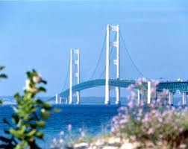
Bridging the Gap: Linking DNP Education and Practice
Dianne Conrad
Kathy Moran
Rosanne Burson

Slide 2
Mackinac Bridge

Slide 3
Objectives
Identify the process of gathering resources to plan a statewide initiative to address DNP education and practice
Describe the effectiveness of roundtable collaborative discussion between practice and academia regarding the DNP
Review outcomes and action plan of a statewide initiative for bridging education and practice

Slide 4
Purpose of DNP Roundtable of Distinction
The purpose of the roundtable was to bring together leaders from education and practice to:
Share insights on the preparation of DNPs, both MSN to DNP and BSN to DNP
Explore evolving roles of the DNP in practice
Explore ways to address the complexity of healthcare delivery through DNP clinical preparation and the collaborative efforts of academicians and practice experts

Slide 5
The DNP Scholarship Team
Scholarship of practice at the doctoral level
Core scholarship team
Administrative, CNS and NP-representing various aspects of advanced practice
Support
Trust/Value
Innovation
Synergy
Gathering other members of the team for specific innovations/initiatives

Slide 6
Scholarship Team Products
Michigan DNP Network
Textbook: The DNP Scholarly Project: A Framework for Success
Planning committees for national DNP conference
Planning for regional DNP efforts
Journal Articles

Slide 7
Donabedian Model
Structure, Process, Outcomes
Outcome
Results for patients and populations
Process
Actions to evaluate and treat patients
Structure
Personnel
Donabedian A. (1988). The quality of care: how can it be assessed? Journal of the American Medical Association, 260, 1743-1748

Slide 8
Guiding Framework: DNP Roundtable Project
Outcomes
Results for patients, populations and DNPs
Process
MiDNP, MCN
Collaboration
Structure
DNP Programs
Healthcare Organizations

Slide 9
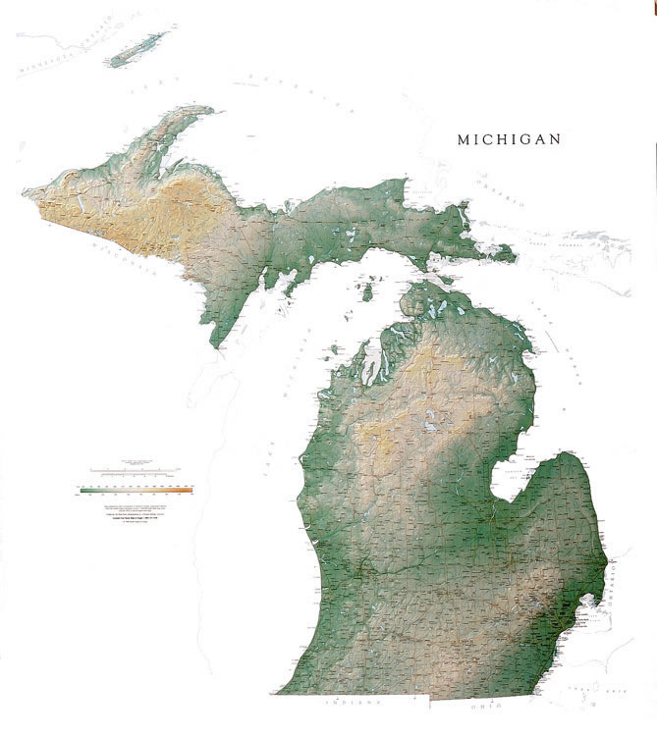
Structure: Geographical Considerations
9 Post-masters and
BSN-DNP programs in Michigan:
Grand Valley State University
Madonna University
Oakland University
University of Michigan, Flint
University of Detroit, Mercy
Wayne State University
Saginaw Valley State University
Michigan State University
University of Michigan
*SVSU
*GVSU
*U of M-Flint
*MSU
*Madonna
*U of M
*UDM
*Oakland
*WSU

Slide 10
Participating Healthcare Organizations
Practice Participants
Bronson Hospital
Sparrow Hospital
Michigan Primary Care Association
Trinity Health
Munson Medical Center
Oakwood Hospital
Hospice of Michigan
Beaumont Hospital
Crittenton Hospital
Allegiance Health
Genesys Health
St. John Providence Healthcare System

Slide 11
Process: Gathering Resources
Invitation from Doctors of Nursing Practice, Inc. for a regional DNP effort
Collaboration between Michigan DNP Network (MIDNP) and Michigan Center for Nursing (MCN)
Merging mission of the organizations, educating the partners on the DNP, and evolution of the format
MCN managed logistics, MIDNP guided content

Slide 12
Process: Innovative Thinking
Speaking to the choir vs. engaging the congregation”
Local Assessment
Always keeping practice in mind

Slide 13
Process: Innovative Thinking
Bringing stakeholders to the table: addressing “what’s in it for them”
Academia identified practice partners
Preparing prior to the event: Efforts to get buy-in from academia and practice partners

Slide 14
Invitation Process
Invitations to DNP educational programs to sponsor and identify practice partners or potential partners
All invitations electronic (as much as possible)
Attention to the amount of information to send out
Practice partners invited, but also expanded to other health care organizations- representatives Home Health, Hospice, Primary care

Slide 15
Invitation Process
Strategic placements to be at each table: Academia, Practice, practicing DNP and DNP student
Practicing DNPs: concept-specific invitation, able to verbalize DNP practice
Academia paid for practice partners to attend
Inclusion of all schools and follow-up with personalized networking

Slide 16
Timeline
Date | Action
Sept, 2012 | Charge from Doctors of Nursing Practice, Inc. to Michigan DNP Network for Regional Meeting
Oct, 2012 | Engaging Partners-Michigan Council of Nursing, Practice and Academia
Oct 2012-June 2013 | Committee Meetings/Conference Calls
Feb, 2013 | Invitation to Deans: Financial Support, Identification of Practice Partners, Students
March, 2013 | Invitation to Practice Partners
June 7, 2013 | Roundtable

Slide 17
Process: Roundtable Agenda Setting the Stage
Ice breaker
What is your greatest challenge?
What would you like to get out of today?
What do you bring to this roundtable discussion?
Summary of Important Points from Ice Breaker
DNP Landscape Presentation
Setting the Stage
Why is the dialogue important

Slide 18
Process: Keynote Speaker
Launette Wohlford DNP, EdD, RN
Dinner meeting the night before: “Fed our nursing spirit”
Keynote message– real life exemplar of DNP innovation in practice from systems viewpoint
Systems view: quality and cost
Need to disseminate utilization of DNP best practices
Realizing the Possibilities…

Slide 19
Process: Roundtable Discussion Format
65 participants
Moderator role: neutral non-nurse
Student Scribes

Slide 20
Process: Student Involvement
Students from DNP programs as roundtable participants and scribes
DNP Posters:
DNPs go to Washington
Caring Nurse Practice in the IntraPartum Setting
Survey on How MI Uses DNPs in Practice
Lessons Learned:
DNP students-stepped up to the challenge
Prep with DNP talking points and roles

Slide 21
Outcomes: Conference Milieu
Ground-breaking event
Not the usual discussion
Non-competiveness

Slide 22
Roundtable Questions:
How can practice doctorates contribute to the IHI Triple Aim: improving the patient experience, improving the health of the population and reducing the per capita cost of healthcare?
Identify challenges and opportunities to utilizing DNP’s within an organization, strategies to overcome challenges and recommendations for action
How can education and practice collaborate to enhance the preparation of the practice doctorate to impact healthcare systems organizational initiatives?

Slide 23
How Can Practice Doctorates Contribute to Triple Aim?
Improve Health | Improving Patient Experience | Reducing Cost
Leadership in: implementing EBP | Best Practices translated in timely fashion to bedside and patient, mentoring nursing | Leadership in: implementing EBP
Care Coordination | Bridge between nursing, administration and medicine | Knowledge in data collection, analysis and project management, return on investment
Providing Quality and Safety Outcomes | “Clinical Champion”-A clinical expert in an increasingly complex health system | “Overall Big Picture Thinking”--System and Individual Patient level thinking
Leaders in Interprofessional Collaboration | Patient Centered Care, Patient Engagement

Slide 24
Utilizing DNPs: Challenges and Opportunities
Challenges | Opportunities
Articulating the Role: Benefits of DNPs to the system and across health care continuum | Educational communication /marketing for practice settings: administration, physicians and other nurses
Cost-Demonstrate added value, ROI | Practice and academia partnership
Support of Nursing for DNP- from administration to bedside nurses | Using DNP Scholarly Project to demonstrate role and value to system
Reporting relationships | DNP database/networking
Lack of evidence to support utilizing DNPs | Repository of DNP outcomes
Lack of mentorship, role modeling for new nursing role | Advocacy for legislation and reimbursement

Slide 25
Collaboration between education and practice to enhance DNP education
True Partnership between Academia and Practice Shared Vision of Care Delivery
Practice Initiatives | Academia Initiatives
Identification of suitable projects-meet goals of DNP education and system sustainability | Formal partnership with practice: shared meetings
Job shadowing/mentoring of students with practicing DNPs | Joint appointments for faculty to bridge education and practice
Role clarification within organizations | Promotion of interprofessional practice and education
Organizational sponsorship/funding | Dissemination forums for best practices by DNPs and students
Consortium of resources/projects database | Promotion of innovation in practice
Residency programs

Slide 26
Outcomes: Bridging Education and Practice Insights
Highlighted MIDNP Network- requests to join
Practicing DNPs and DNP students
Educated academia and practice on the DNP in practice
Take advantage of every
opportunity to engage students
in DNP work

Slide 27
Outcomes: Action Plans
A workgroup was proposed to develop DNP Talking Points directed at practice organizations across the continuum
An online data base/repository housed in the Michigan Center for Nursing was proposed to catalog:
Completed Michigan DNP projects
Practice opportunities for potential DNP projects
DNP student innovations/project proposals for practice.

Slide 28
Outcomes: Action Plans
Continue subsequent DNP conferences with Academia and Practice
Regional DNP conference was proposed to share best practices of Michigan DNP education and practice and student projects.
Develop a DNP Strategic Plan for Michigan to highlight insights gained in the Roundtable discussion

Slide 29
Next Steps: Moving forward…
Follow up group work on implementation of recommendations
Yearly conference and report back with new initiatives
Continue the conversation
Showcase DNP excellence in practice
Complete White Paper

Slide 30
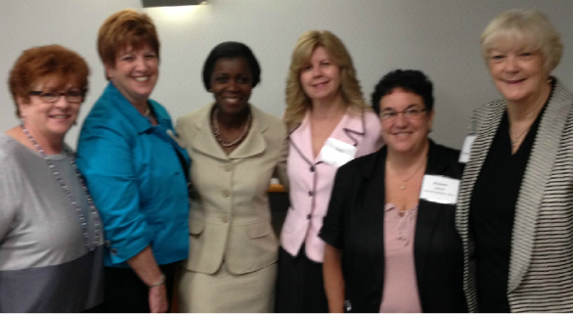
Katy Kessler (MCN), Dianne Conrad (MiDNP), Launette Woolforde (keynote presenter), Kathy Moran (MiDNP),Rosanne Burson (MiDNP), Carole Stacy (MCN)
2013 Roundtable of Distinction: Healthcare Transformation in Michigan: The Scholarship Team

